Slide 1
How epithelial cytokines correlate the clinical features of asthma
Veeva ID: Z4-39011; date of preparation: November 2021
This information is intended for healthcare professionals only
EpiCentral is sponsored by AstraZeneca and Amgen

Slide 2
Multiple clinical features of asthma are associated with epithelial cytokines^{1–9}
Epithelial cytokines
Asthma
Severity^{1,2}
Reduced lung function¹
Potential
airway remodelling^{3,4}
Reduced steroid response⁵
Exaggerated T2 response to viral infections^{6–9}
T2, type 2 1. Li Y, et al. J Immunol 2018;200:2253–2262; 2. Shikotra A, et al. J Allergy Clin Immunol 2012;129:104–111; 3. Cao L, et al. Exp Lung Res 2018;44:288–301; 4. Wu J, et al. Cell Biochem Funct 2013;31:496–503; 5. Liu S, et al. J Allergy Clin Immunol 2018;141:257–268; 6. Lee HC, et al. J Allergy Clin Immunol 2012;130:1187–1196; 7. Uller L, et al. Thorax 2010;65:626–632; 8. Kato A, et al. J Immunol 2007;179:1080–1087; 9. Beale J, et al. Sci Transl Med 2014;6:256ra134

Slide 3
Airway epithelial cytokine expression increases with disease severity in patients with asthma^{1,2}
TSLP expression increased with asthma severity¹*
IL-33 concentration increased with asthma severity¹*
1000
100
P=0.0393
TSLP (pg/mL)
P=0.0428
P=0.0202
Log IL-33 (pg/mL)
P=0.0342
P=0.0378
P=0.043
100
10
10
1
1
0.1
0.1
Healthy controls
Mild asthma³
(no ICS or OCS)
Mild-to-severe asthma requiring ICS³ (no OCS)
ICS + OCS dependent asthma
Healthy controls
Mild asthma³
(no ICS or OCS)
Mild-to-severe asthma requiring ICS³ (no OCS)
ICS + OCS dependent asthma
n=30
n=29
n=21
n=20
n=30
n=29
n=21
n=20
Figures adapted from Li Y, et al. J Immunol 2018;200:2253–2262 Note: In-house ELISA platforms developed by Novartis, with lower limits of detection of 1 and 2 pg/mL, were used to analyse TSLP in BALF. Normal control patients were healthy, lifelong non-smoking volunteers who had no history of lung disease¹
*BALF was used to measure the concentrations of TSLP or IL-33 (patients with asthma, n=70; controls, n=30)¹
BALF, bronchoalveolar lavage fluid; ELISA, enzyme-linked immunosorbent assay; ICS, inhaled corticosteroid(s); IL, interleukin; OCS, oral corticosteroid(s); TSLP, thymic stromal lymphopoietin
1. Li Y, et al. J Immunol 2018;200:2253–2262; 2. Shikotra A, et al. J Allergy Clin Immunol 2012;129:104–111; 3. Global Initiative for Asthma (GINA). Global Strategy for Asthma Management and Prevention. 2021. Available from: https://ginasthma.org/wp-content/uploads/2021/04/GINA-2021-Main-Report_FINAL_21_04_28-WMS.pdf (Accessed 13 December 2021)

Slide 4
Airway epithelial cytokine expression correlates with reduced lung function in patients with asthma¹
Higher TSLP expression correlated with reduced FEV₁¹
Higher IL-33 expression correlated with reduced FEV₁¹
150
All patients with asthma
(n=70)
150
All patients with asthma (n=70)
FEV₁ (%)
FEV₁ (%)
r=−0.565*
P<0.0001
r=−0.488*
P<0.0001
120
120
90
90
60
60
30
30
0
50
100
150
200
0
5
10
15
20
25
TSLP (pg/mL)
IL-33 (pg/mL)
Figures adapted from Li Y, et al. J Immunol 2018;200:2253–2262
BALF was used to measure the concentrations of TSLP and IL-33. Spearman rank-order method with correction for tied values was used to obtain correlation coefficients
*Spearman rank-order correlation coefficient
BALF, bronchoalveolar lavage fluid; FEV₁, forced expiratory volume in 1 second; IL, interleukin; TSLP, thymic stromal lymphopoietin 1. Li Y, et al. J Immunol 2018;200:2253–2262

Slide 5
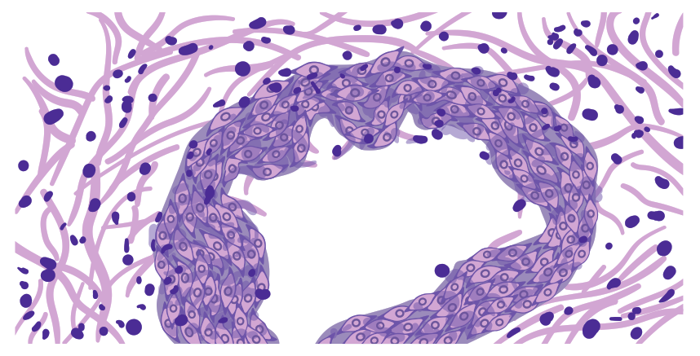
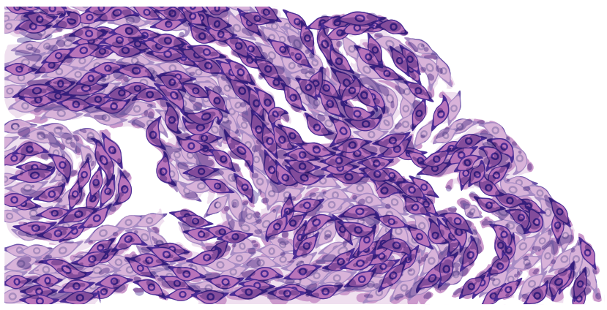
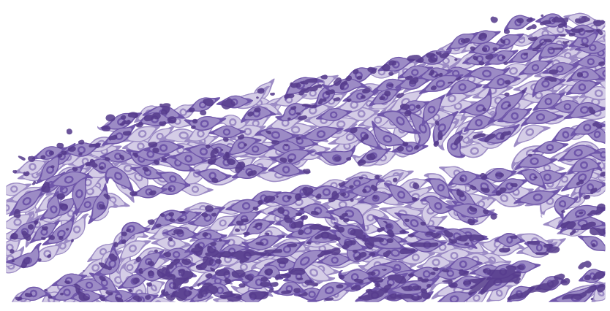
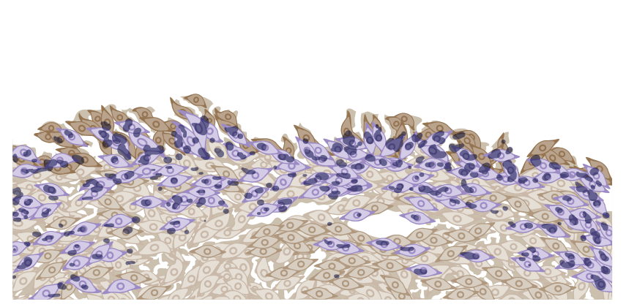
TSLP may contribute to airway remodelling in patients with asthma^{1,2}
Bronchial airway epithelial cells
in asthma versus healthy controls¹
In human lung fibroblasts, TSLP increased expression of collagen and smooth muscle actin in a concentration-dependent manner (P<0.05*)^{1,2}
Normal
Asthma
Smooth muscle actin (N=3) Collagen (N=3)
Relative protein level
1.0
‡
‡
Standard H&E staining
†
†
0.5
TSLP staining
(in brown)
0
0
1.5
2.5
4.0
TSLP concentration (µg/mL)
Figures adapted from Cao L, et al. Exp Lung Res 2018;44:288–301
Human bronchial epithelial cells were stained with H&E or Masson Trichrome
*vs GADPH control; †P<0.05 vs GADPH control (smooth muscle actin); ‡P<0.05 vs GADPH control (collagen)
GAPDH, glyceraldehyde-3-phosphate dehydrogenase; H&E, haematoxylin and eosin; TSLP, thymic stromal lymphopoietin
1. Cao L, et al. Exp Lung Res 2018;44:288–301; 2. Wu J, et al. Cell Biochem Funct 2013;31:496–503

Slide 6
IL-33 and IL-25 may promote airway remodelling in patients with asthma^{1–4}
In human lung fibroblasts, IL-33 increased expression of fibronectin 1 and type I collagen in vitro²
In human bronchial biopsies, RBM thickness was greater in patients with asthma and high IL-25 versus low IL-25 (P=0.0006)⁴
P<0.0001
Fibronectin 1 / β-actin (N=3)
Type I collagen / β-actin (N=3)
15
P=0.041
P=0.0006
6
Basement membrane thickness (µm)
Relative protein level
5
*
4
**
10
3
*
**
2
5
1
0
0
IL-33
(ng/mL)
–
1
10
100
Control
n=21
Low
n=22
High
n=21
IL-25
Figure adapted from Guo Z, et al. J Asthma 2014;51:863–869 and Cheng D, et al. Am J Respir Crit Care Med 2014;190:639–648
*P<0.05 vs controls; **P<0.01 vs controls
IL, interleukin; RBM, reticular basement membrane thickness
1. Saglani S, et al. J Allergy Clin Immunol 2013;132:676–685; 2. Guo Z, et al. J Asthma 2014;51:863–869; 3. Préfontaine D, et al. J Immunol 2009;183:5094–5103;
4. Cheng D, et al. Am J Respir Crit Care Med 2014;190:639–648

Slide 7
Some epithelial cytokines may be associated with corticosteroid resistance in patients with asthma^{1–4}
Blood and BALF ILC2s exposed to TSLP were resistant to steroids¹*
Steroid resistance correlated with higher airway TSLP expression, higher BALF and blood eosinophils, and lower FEV₁ (P≤0.003)¹
In patients with asthma, TSLP levels correlated with reduced steroid response¹
Dexamethasone effect on ILC2s (%)§
r=−0.73¶
P<0.001
N=20
60
50
IL-33 expression levels remained elevated after treatment with steroids in human bronchial biopsies² and ASMCs³
40
30
20
ICS significantly improved lung function in patients with high plasma IL-25 versus low plasma IL-25^{4†}
Plasma IL-25 was significantly decreased after 4 weeks of ICS treatment, demonstrating sensitivity to steroids^{4‡}
10
0
0
20
40
60
80
100
TSLP in BALF (pg/mL)
Figure adapted from Liu S, et al. J Allergy Clin Immunol 2018;141:257–268 *Resistance to steroids meant a lack of inhibition of T2 cytokine expression by ILC2s; †high plasma IL-25 threshold, >55 pg/ml and low plasma IL-25 threshold, ≤55 pg/mL; ‡decrease of IL-25 was mainly observed in IL-25-high patients; §BALF ILC2s in patients with asthma were examined (n=50). Controller medications were maintained (SCS and ICS medications); ¶Pearson correlation coefficient
ASMC, airway smooth muscle cell; BALF, bronchoalveolar lavage fluid; FEV1, forced expiratory volume in 1 second; ICS, inhaled corticosteroid(s); IL, interleukin; ILC2, type 2 innate lymphoid cell; SCS, systemic corticosteroid(s); T2, type 2; TSLP, thymic stromal lymphopoietin 1. Liu S, et al. J Allergy Clin Immunol 2018;141:257–268; 2. Saglani S, et al. J Allergy Clin Immunol 2013;132:676–685; 3. Préfontaine D, et al. J Immunol 2009;183:5094–5103;
4. Cheng D, et al. Am J Respir Crit Care Med 2014;190:639–648

Slide 8
Epithelial cytokine release following viral infection drives T2 response in patients with asthma^{1,2}
Following viral infection, TSLP release is increased from bronchial epithelial cells of patients with asthma¹*
24 hours post-viral infection, IL-25 release is increased from bronchial epithelial cells of patients with asthma^{2†}
10000
30
P<0.05
P<0.05
Human TSLP (pg/mL)
P=0.01
IL-25 (pg/mL)
P<0.05
1000
20
100
10
10
1
Healthy control
Healthy
RSV A2
Asthma control
Asthma RSV A2
0
Asthma Mock infected
Asthma Rhinovirus
Healthy Mock infected
Healthy Rhinovirus
n=12
n=10
n=10
Figure adapted from Lee H-C, et al. J Allergy Clin Immunol 2012;130:1187–1196
Figure adapted from Beale J, et al. Sci Transl Med 2014;6:256ra134
*n=12 patients for all groups; †bronchial epithelial cells were obtained from 10 patients with moderate atopic asthma and 10 non-atopic, non-asthmatic healthy volunteers
IL, interleukin; RSV, respiratory syncytial virus; T2, type 2; TSLP, thymic stromal lymphopoietin 1. Lee H-C, et al. J Allergy Clin Immunol 2012;130:1187–1196; 2. Beale J, et al. Sci Transl Med 2014;6:256ra134

